Slide 1
Job Market Analysis & Experience Prediction using Naukri Data
Alpana Prajapati
Data Scientist

Slide 2
Problem Statement
To Analyze job market trends to identify in-demand skills and predict experience levels required for the roles.

Slide 3
Project Overview & Objective
This project analyzes data science job listings to uncover key skill requirements, hiring trends, and experience demands.
It combines web scraping, data preprocessing, EDA, Power BI dashboards, and a classification model to predict experience levels.
Tools Used: MS Excel | Power BI | Python | Machine Learning
Objective:
To understand hiring patterns, skill demand, and build a predictive model for experience level classification.

Slide 4
Data Collection (Web Scraping)
Source: Naukri.com
Tools used for Web Scraping: Selenium, BeautifulSoup4
Number of pages scraped: 100 pages
The dataset contains job-related information such as job title, location, company, reviews, ratings, required skills, and experience levels

Slide 5
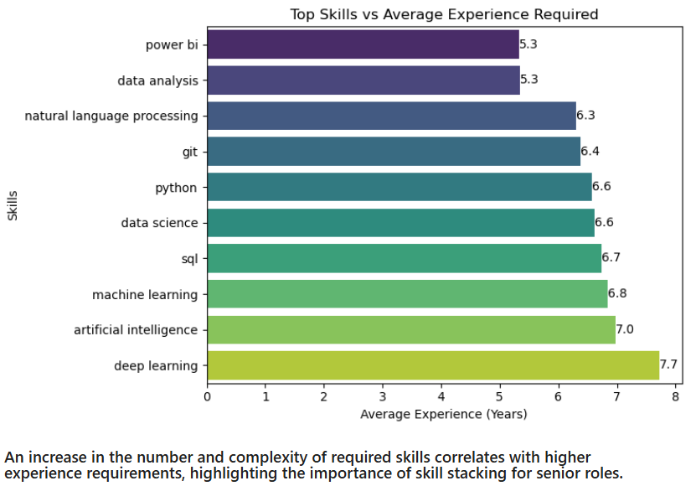
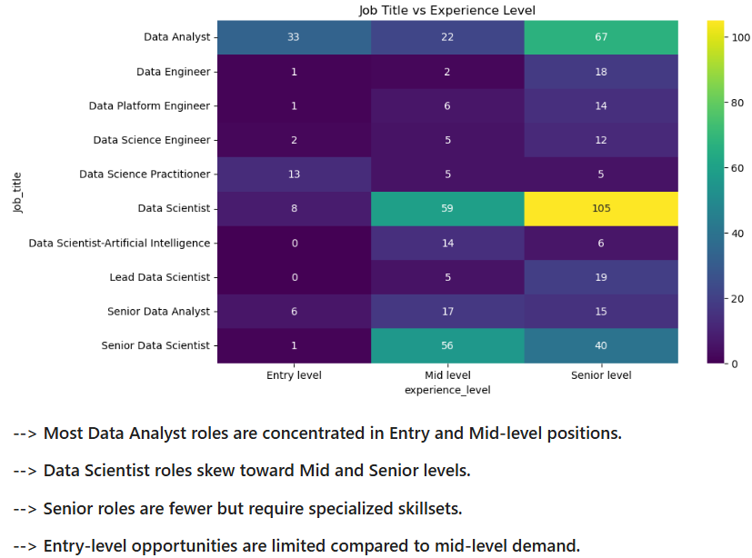
EDA & Visualizations

Slide 6
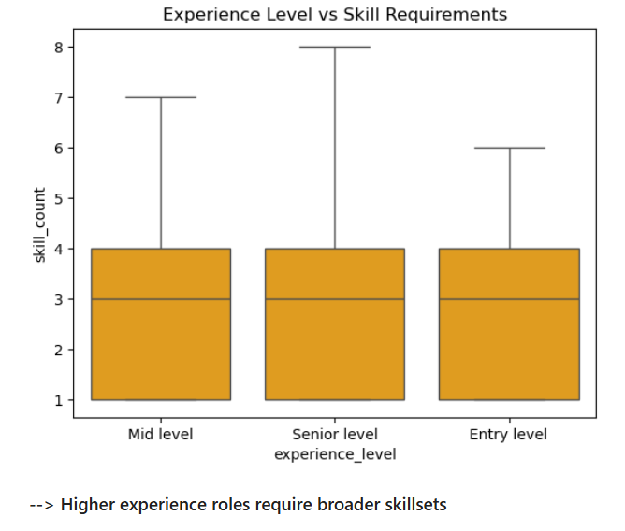
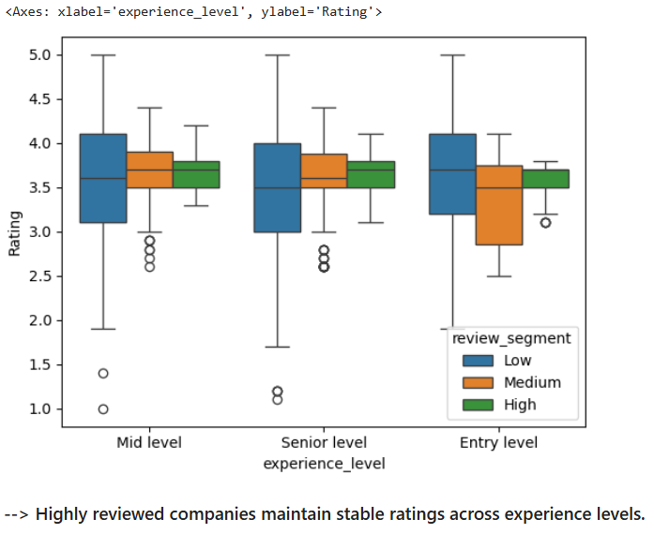
Experience level

Slide 7
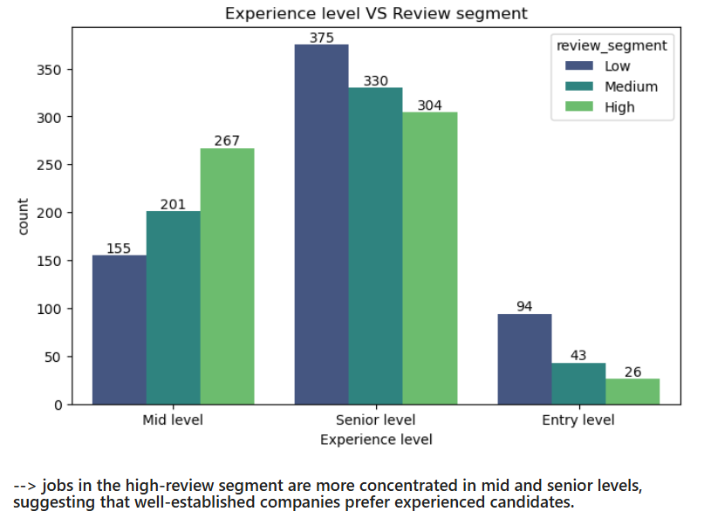
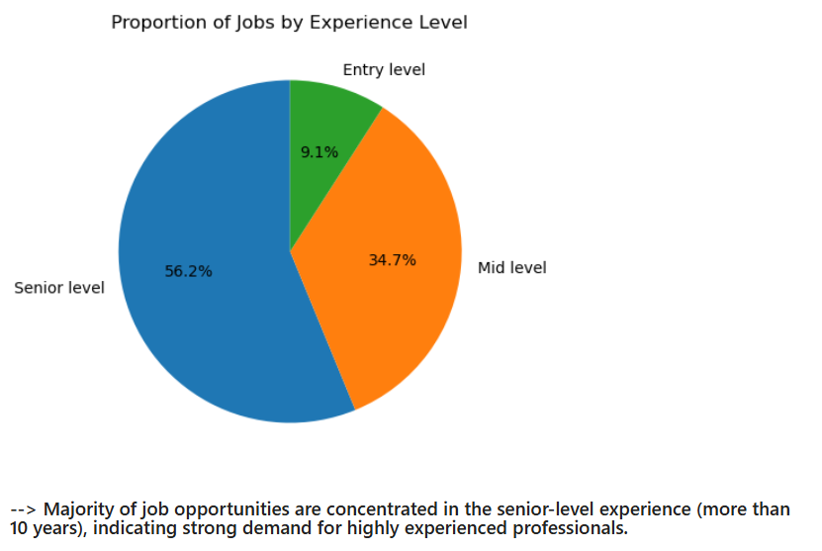
Proportion and Experience level VS Review segment

Slide 8
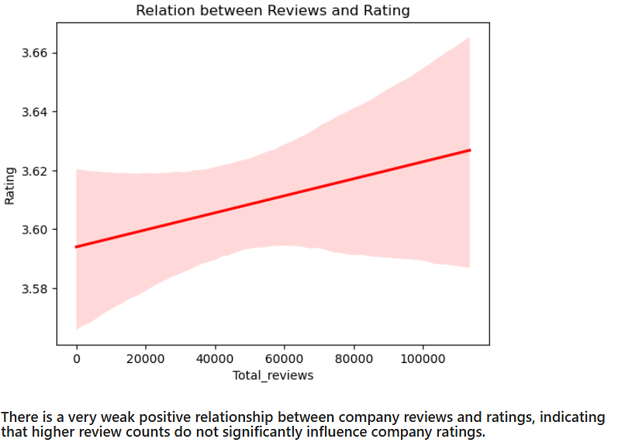
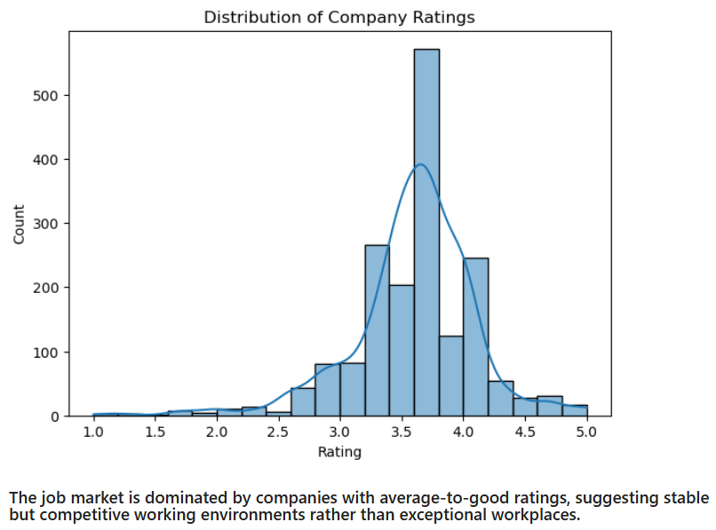
Company Ratings and job review

Slide 9
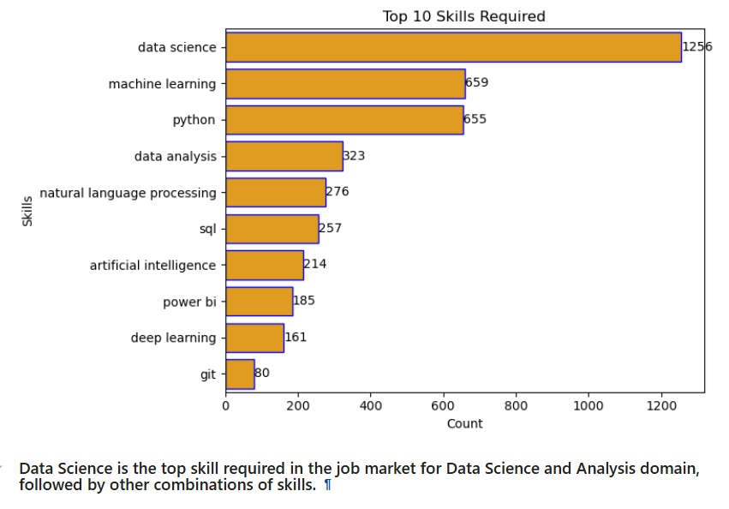
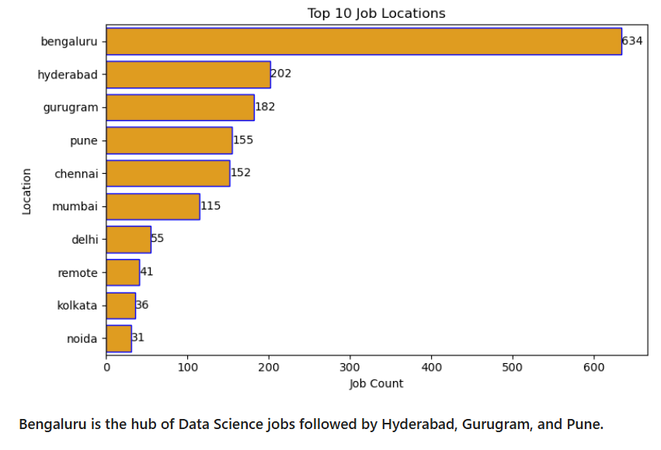
Top 10 Skills Required and Job Location

Slide 10
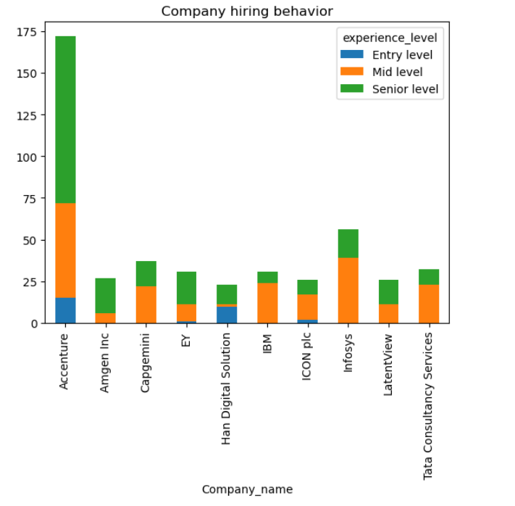
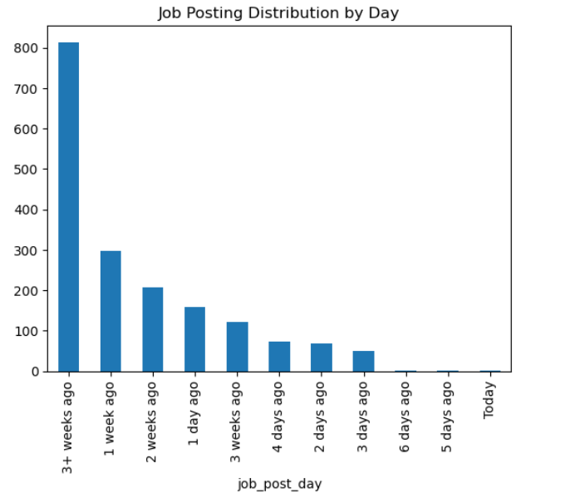
Company hiring behavior and Job posting distribution
Most companies, especially Accenture have a higher number of openings for senior-level and mid-level roles compared to Entry-level positions, indicating a stronger demand for experienced professionals in the job market.
Most job [postings in the dataset are older than 3 weeks, with very few recent listings. this indicates that the data is heavily skewed toward outdated jobs and may not accurately reflect current job market activity.

Slide 11
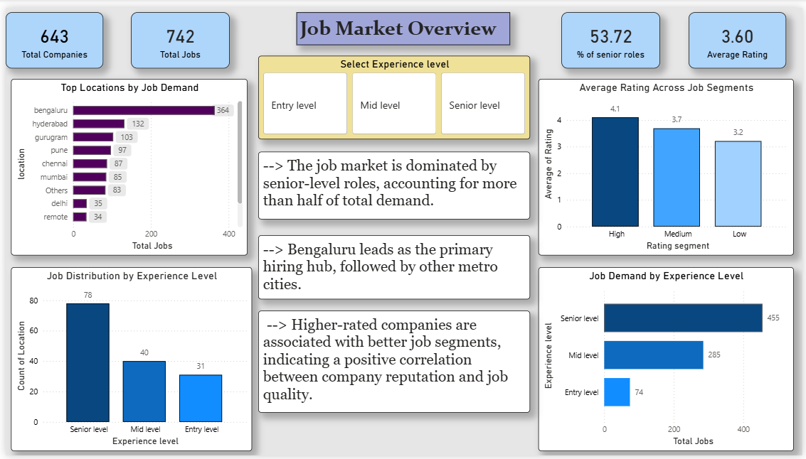

Slide 12
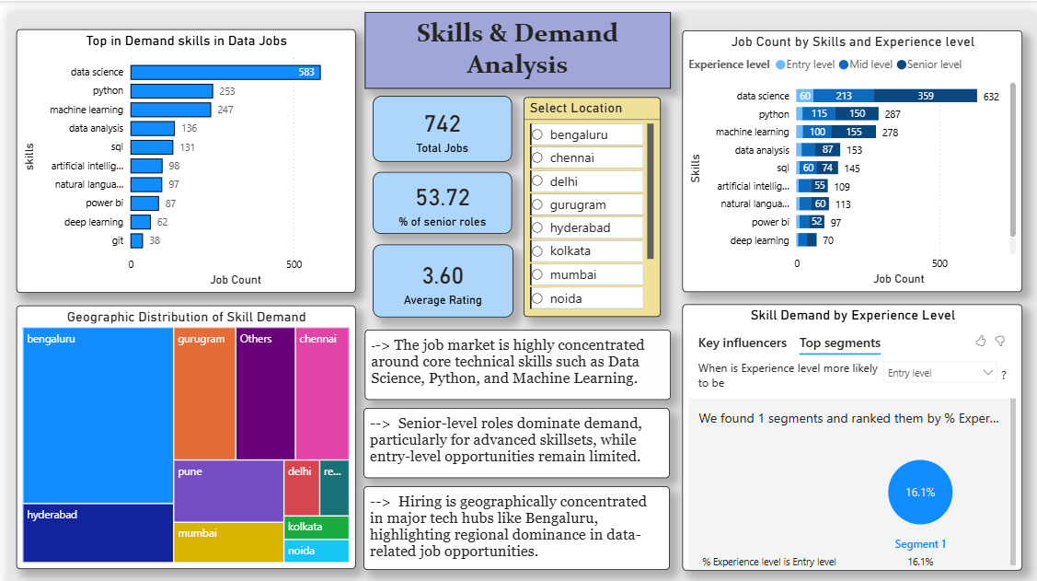

Slide 13
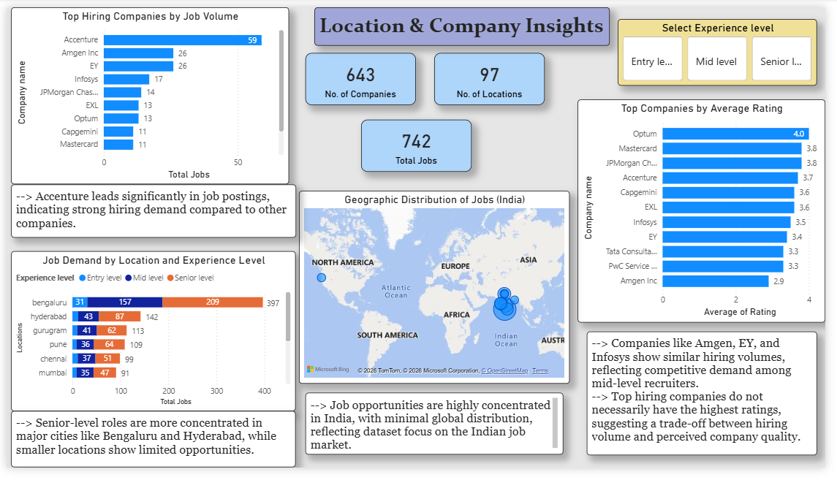

Slide 14
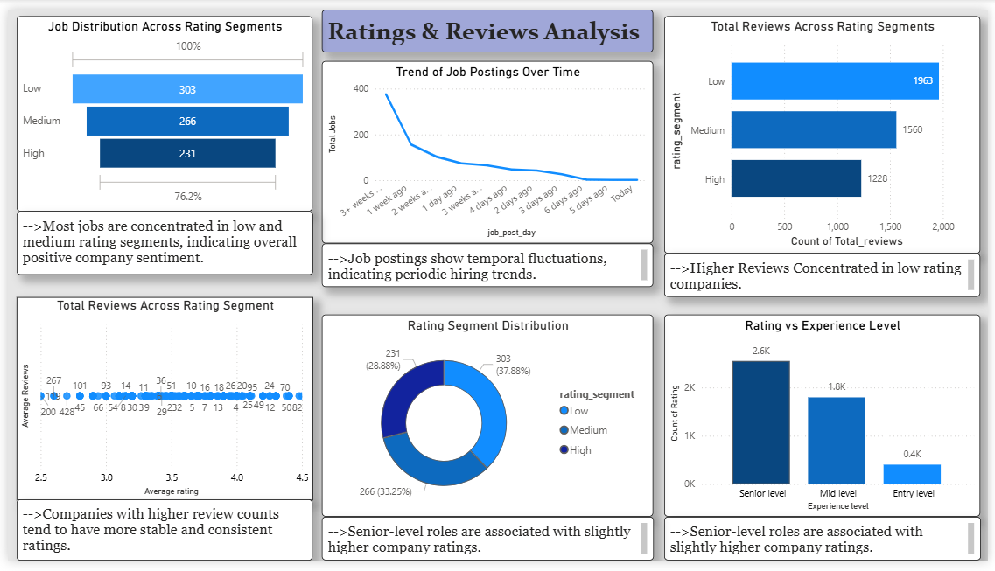

Slide 15
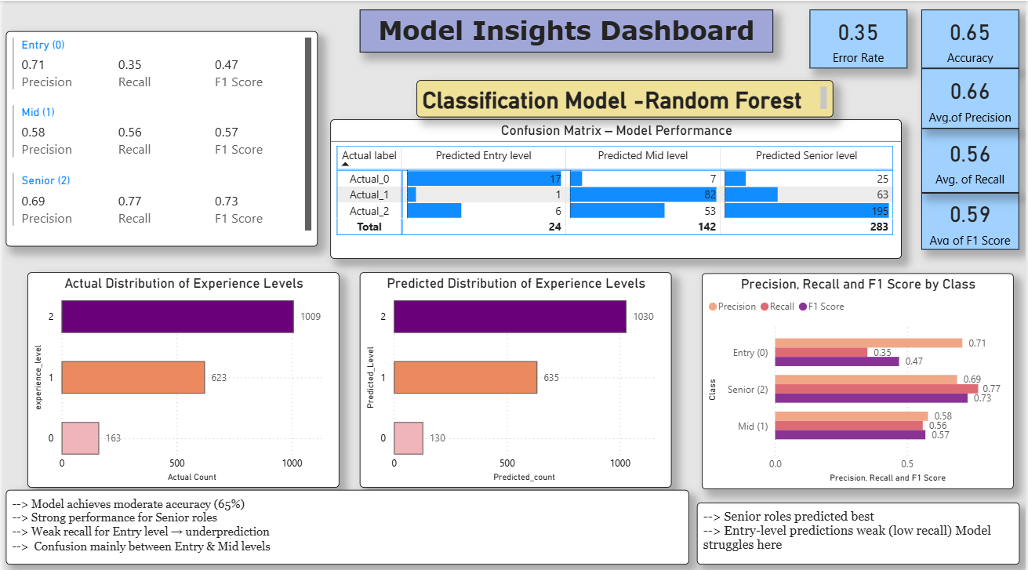

Slide 16
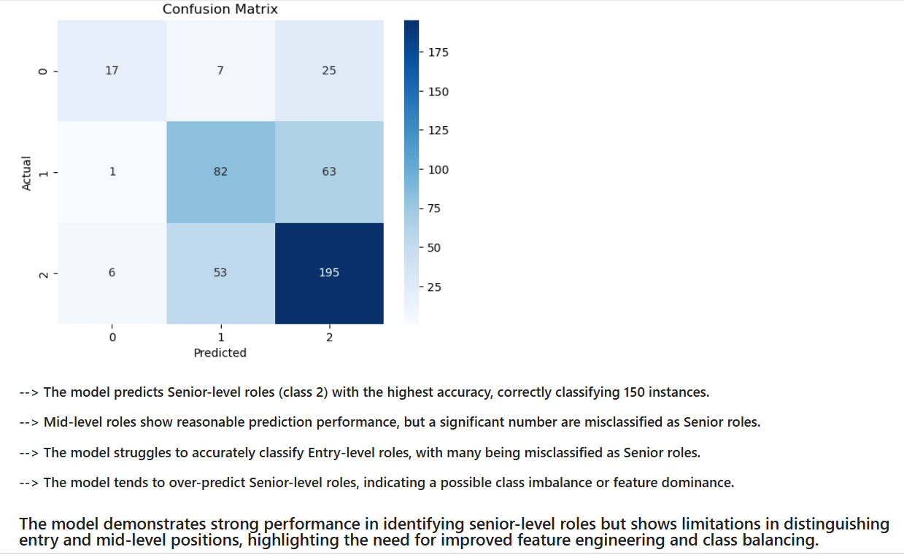
Confusion Matrix

Slide 17
Key Findings
Skill Demand: Data Science, Python, and Machine Learning are the most in-demand skills.
Experience Distribution: Most job opportunities are concentrated in mid and senior-level roles, with fewer entry-level openings.
Location Trend: Job demand is highly concentrated in cities like Bengaluru, Hyderabad, and Gurugram.
Company Ratings: Most companies fall within medium to high rating segments, indicating generally positive employer feedback.
Model Performance: The classification model achieved around 65% accuracy, with better performance for senior-level roles.

Slide 18
Key Insights
The Dominance of Python and Data Science skills highlights their importance as core requirements in the current job market.
The lower number of entry-level roles suggests higher competition for freshers and a preference for experienced candidates.
The concentration of jobs in metro cities reflects the presence of tech hubs and industry demand.
The model’s higher performance for senior roles indicates clearer patterns in experienced job requirements, while entry-level roles show overlap.

Slide 19
Recommendations
For Job Seekers: Focus on building strong skills in Python, data analysis, and machine learning to increase employability.
For Freshers: Since entry-level roles are limited, candidates should focus on internships, projects, and certifications to stand out.
For Companies: Organizations can improve hiring efficiency by clearly defining skill requirements for entry-level roles to reduce ambiguity.
For Decision-Making: The predictive model can be used to classify job roles and assist in workforce planning and talent analysis.

Slide 20
Conclusion
The analysis reveals that the job market is highly concentrated in specific locations and skill sets.
The predictive model demonstrates strong performance and can assist in understanding hiring patterns.

Slide 21


